Slide 1
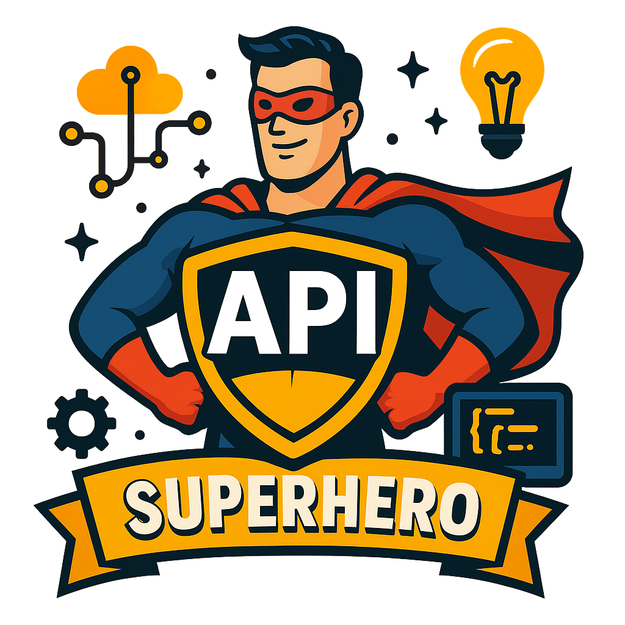
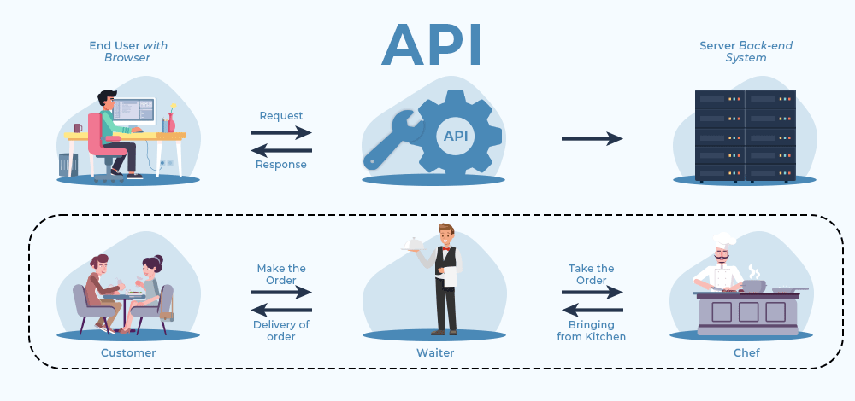
What is APIs ?
API stands for Application Programming Interface.
At its core, an API is a bunch of code that takes an input and gives you predictable outputs.
Think of an API as a middleman that enables applications to interact without needing direct access to each other's code or database.

Slide 2
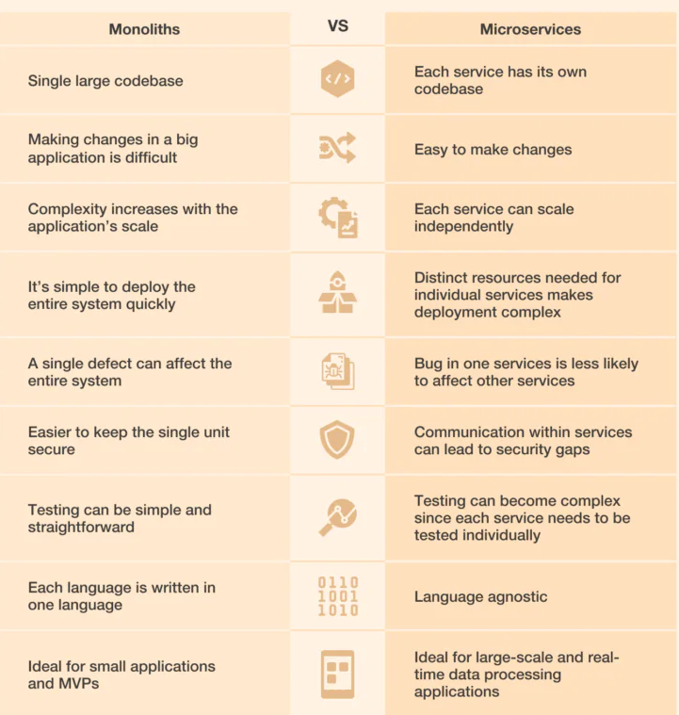
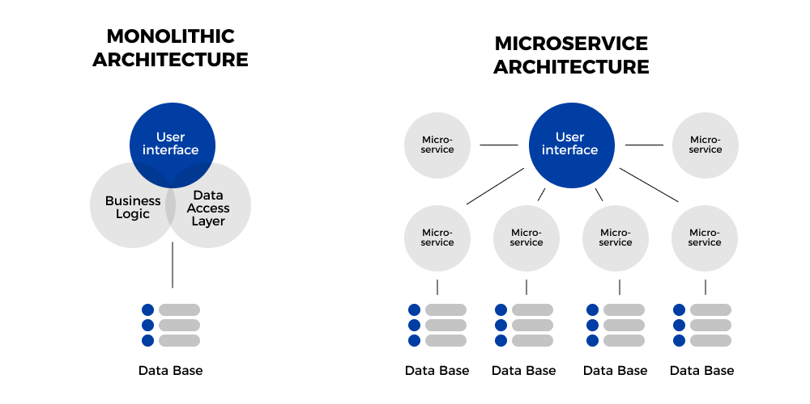
Monolithic Vs Microservices Architecture?

Slide 3
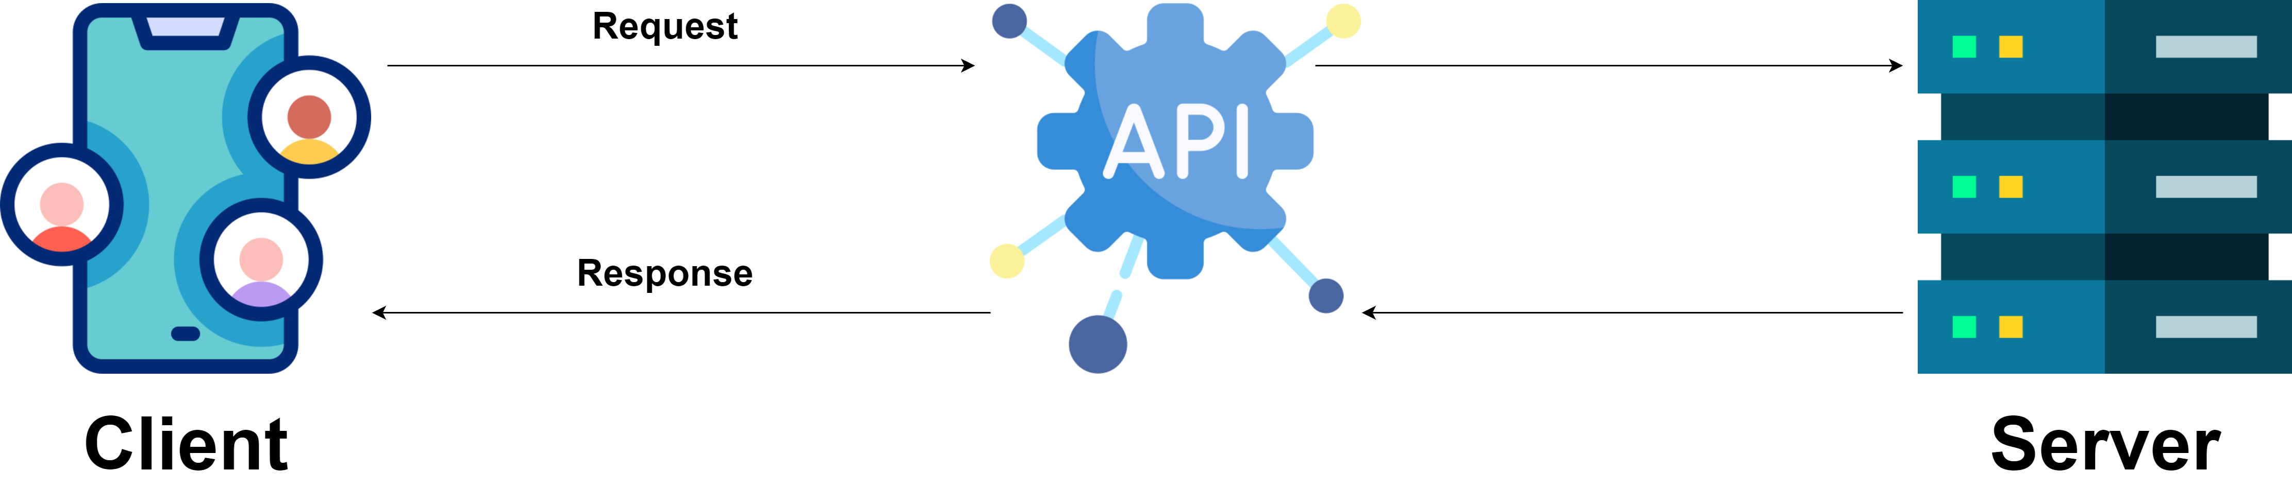
How API power modern Applications?
The apps you use every day whether it's Gmail, Instagram, Uber, or Spotify are essentially a collection of APIs with a polished user interface (UI) on top.
Most applications follow the frontend/backend architecture, where:
The backend consists of APIs that handle data processing, business logic, and communication with databases.
The frontend is a graphical user interface (GUI) that interacts with these APIs, making applications user-friendly and accessible without requiring users to write code.
APIs follow a simple request-response model:
A client (such as a web app or mobile app) makes a request to an API.
The API (hosted on an API server) processes the request, interacts with the necessary databases or services, and prepares a response.
The API sends the response back to the client in a structured format (usually JSON or XML).

Slide 4
Types of APIs
Open APIs
(Public APIs)
Internal APIs (Private APIs)
Code Interfaces
Open APIs, also known as Public APIs, are accessible to external developers with minimal restrictions.
Companies provide these APIs to encourage third-party developers to integrate their services and build new applications on top of them. Ex. YouTube Data API
Internal APIs, also known as Private APIs, designed exclusively for internal use within an organization. Unlike Open APIs, these are not accessible to external developers and are used to facilitate seamless communication between different internal systems within a company.
Ex. Internal Company API.
The first two types of APIs we discussed—Open APIs and Internal APIs—are functional and serve real-world use cases like fetching weather data or booking a ride.
But there’s another category of APIs that developers use daily: Code Interfaces (also called Library APIs or Programming APIs).

Slide 5
API Communication Methods
REST (Representational State Transfer)
SOAP (Simple Object Access Protocol)
GraphQL
gRPC
REST is the most widely used API communication method today. It is lightweight, stateless, and scalable, making it perfect for web services and mobile applications.
REST APIs follow a set of design principles and use HTTP methods (GET, POST, PUT, DELETE) to perform operations.
SOAP is an older API communication method that relies on XML-based messaging.
Unlike REST, which is lightweight, SOAP is more structured and secure, making it ideal for banking, healthcare, and enterprise applications.
GraphQL is an alternative to REST that allows clients to request exactly the data they need, making it more efficient for modern applications. Unlike REST, which requires multiple API calls to fetch related data, GraphQL can fetch all necessary data in a single request.
gRPC (Google Remote Procedure Call) is a high-performance API communication method that uses Protocol Buffers (Protobuf) instead of JSON or XML, making it faster and more efficient.

Slide 6

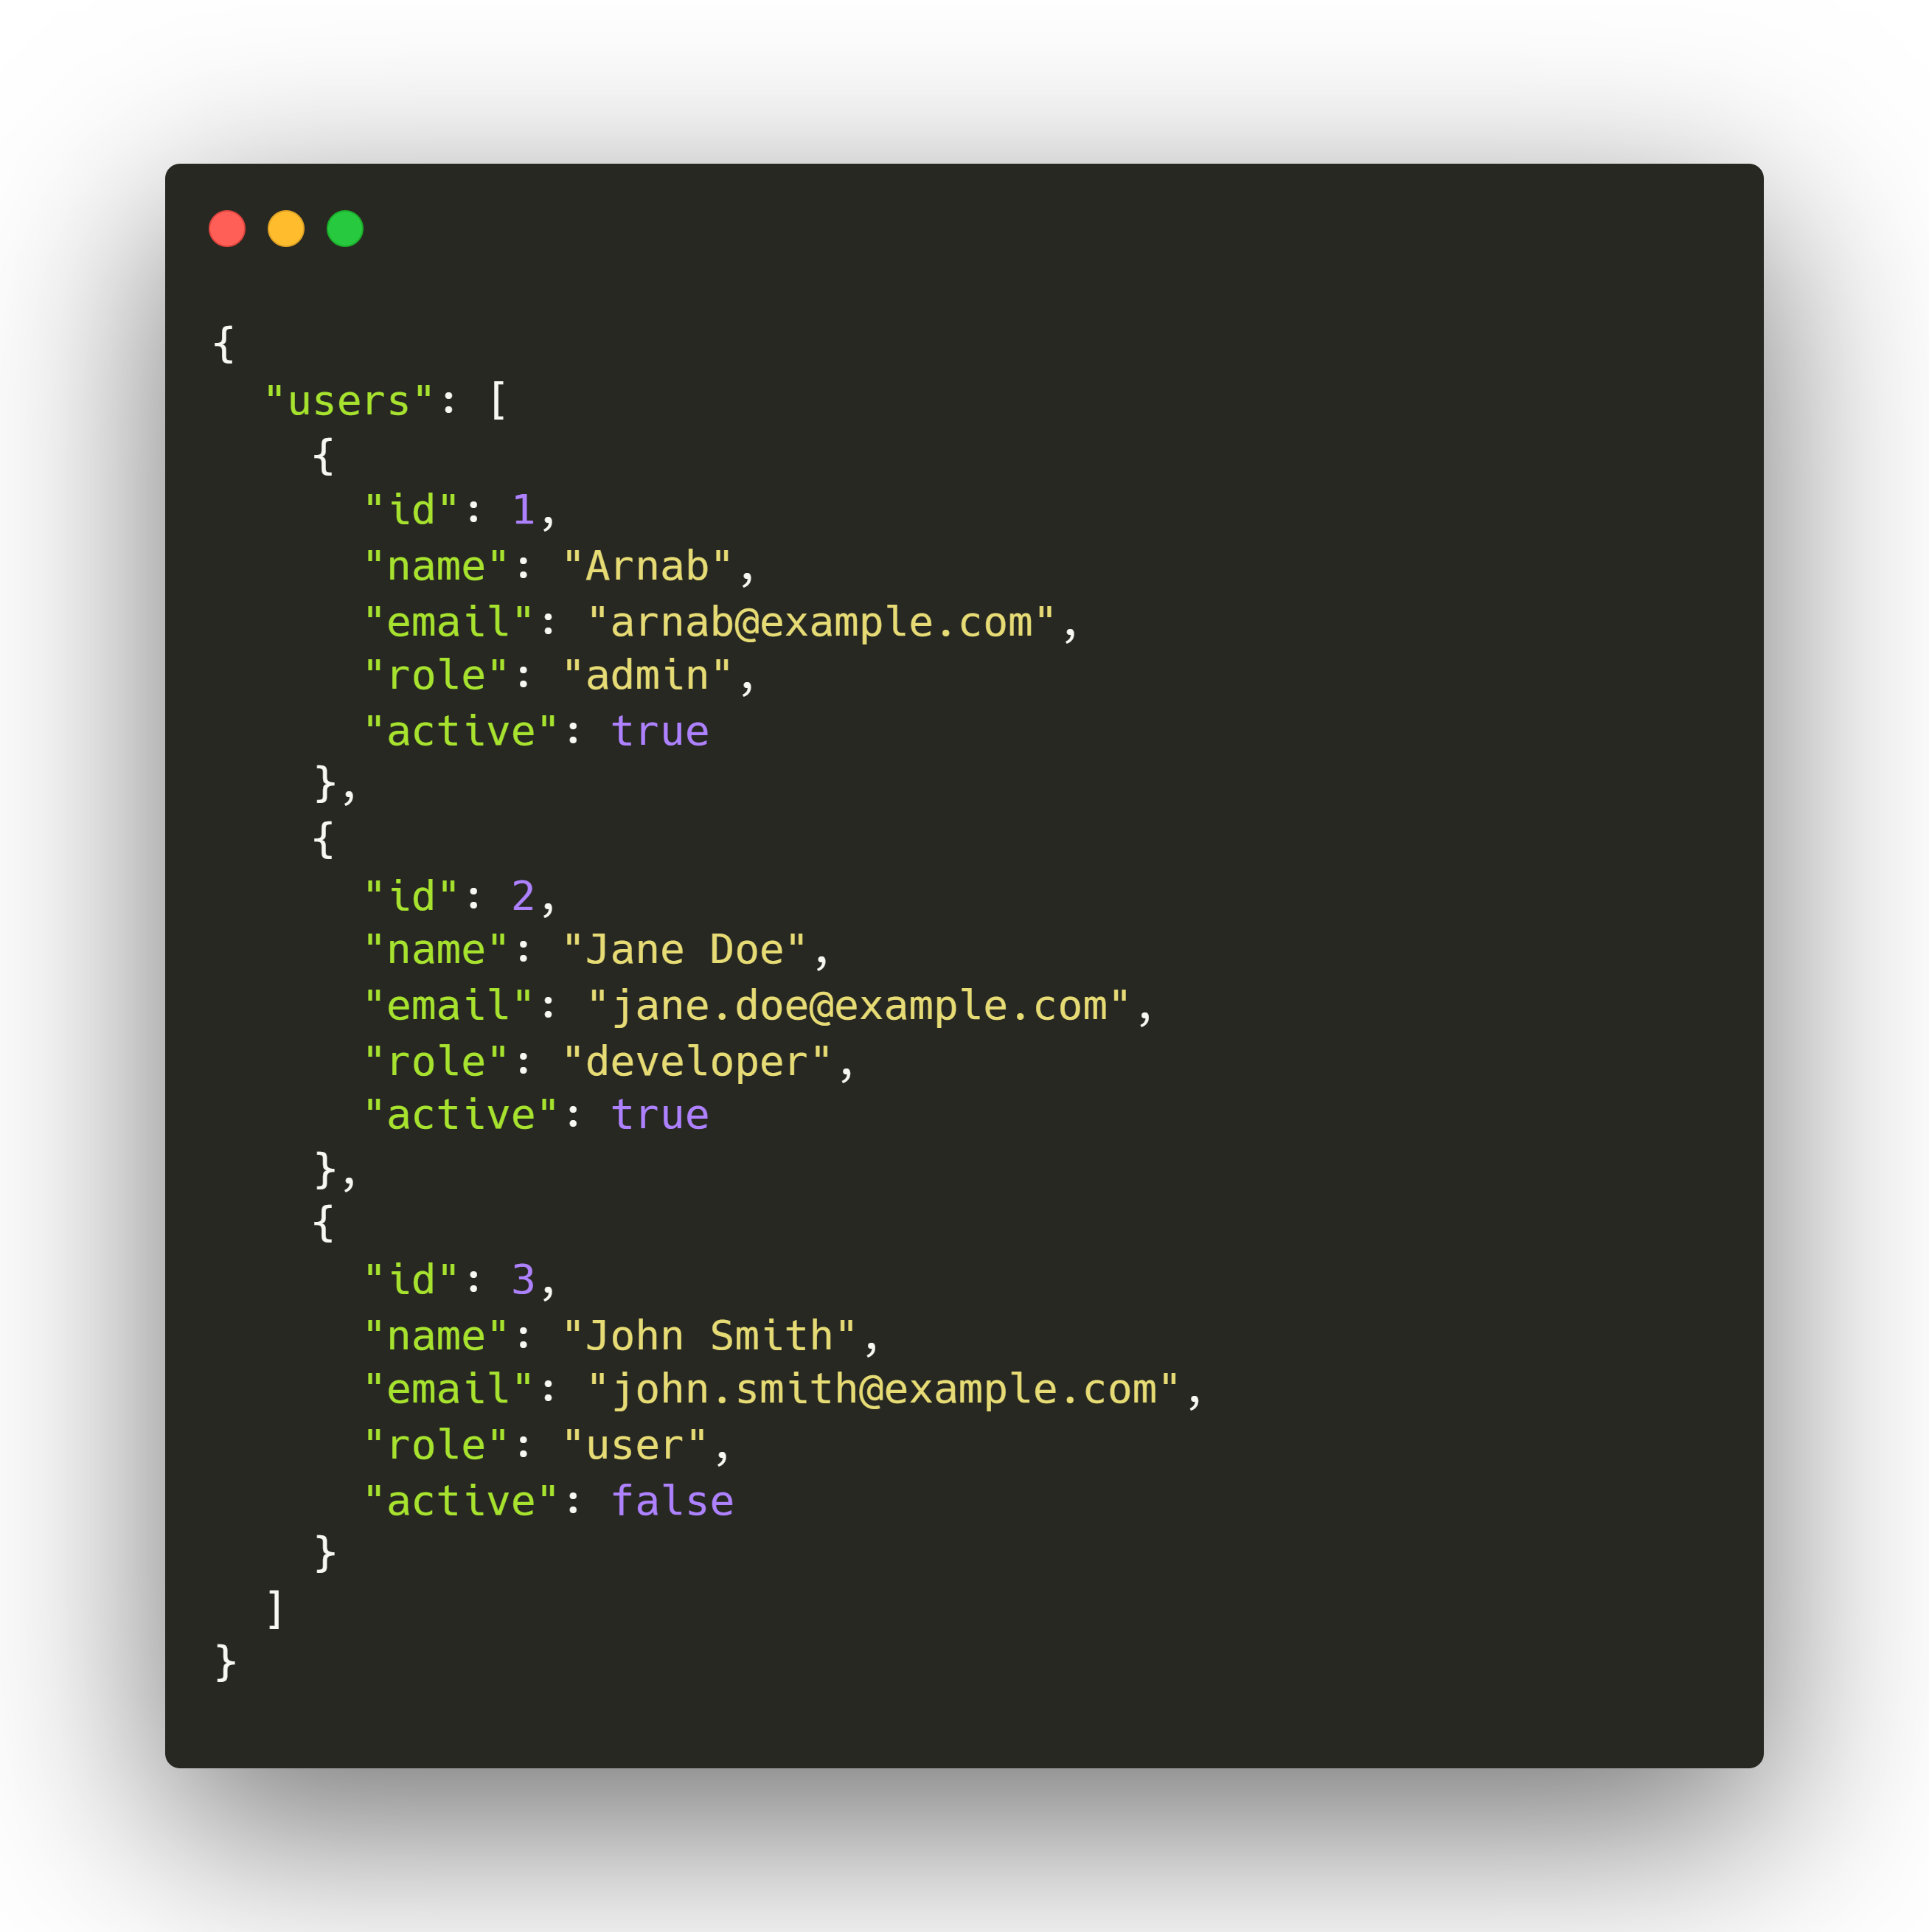
REST API (Representational State Transfer)
REST is the most widely used API communication method today. It is lightweight, stateless, and scalable, making it perfect for web services and mobile applications.
REST APIs follow a set of design principles and use HTTP methods (GET, POST, PUT, DELETE) to perform operations.
REST APIs are based on resources, and each resource is accessed through a URL (endpoint). The API follows the client-server model, meaning the client sends a request, and the server processes it and sends a response.
Example: REST API to Fetch Users
Retrieve a list of users (GET Request):

Slide 7
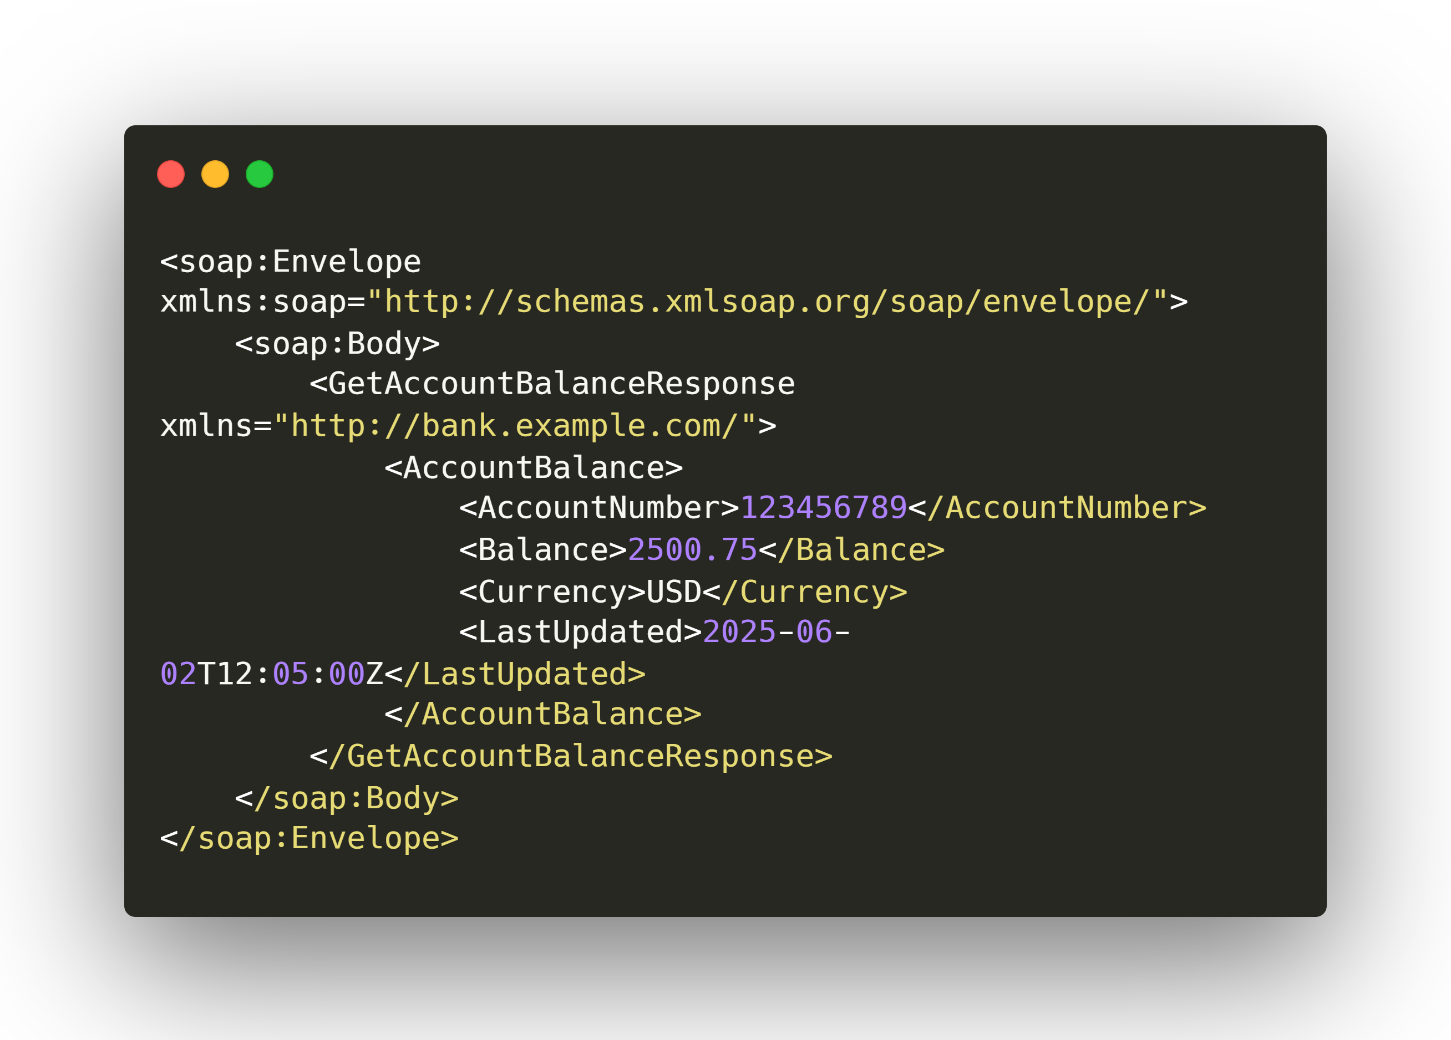
SOAP (Simple Object Access Protocol)
SOAP is an older API communication method that relies on XML-based messaging.
Unlike REST, which is lightweight, SOAP is more structured and secure, making it ideal for banking, healthcare, and enterprise applications.
SOAP messages are sent using XML format and require a WSDL (Web Services Description Language) file, which defines the API's available functions and request structure.
Example: SOAP API for a banking service
Fetching account balance:

Slide 8
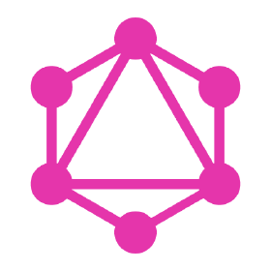
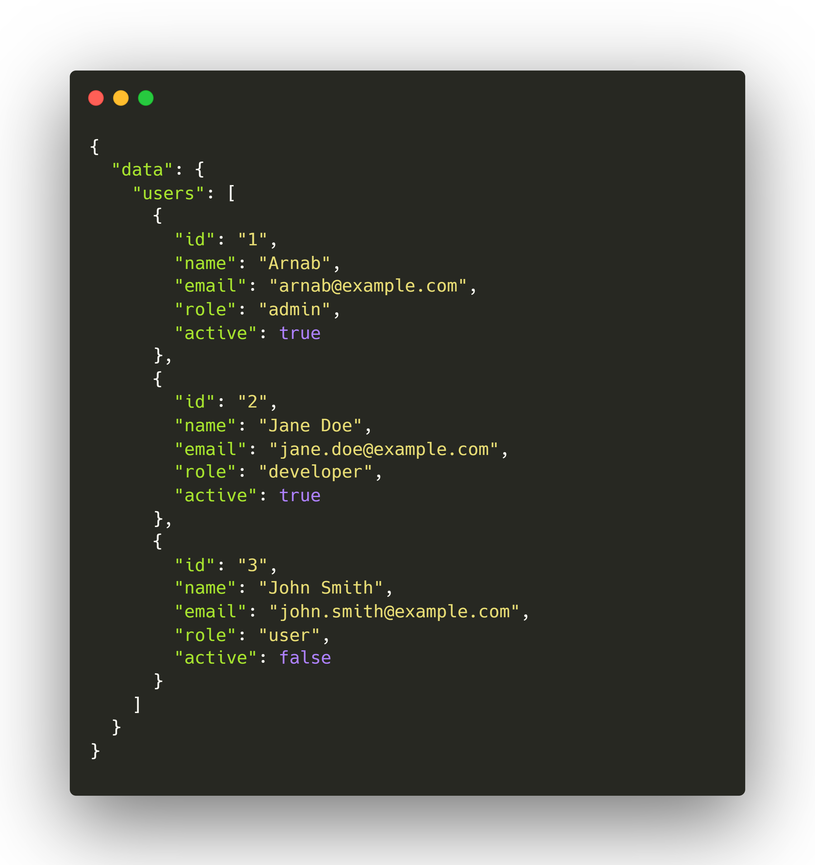
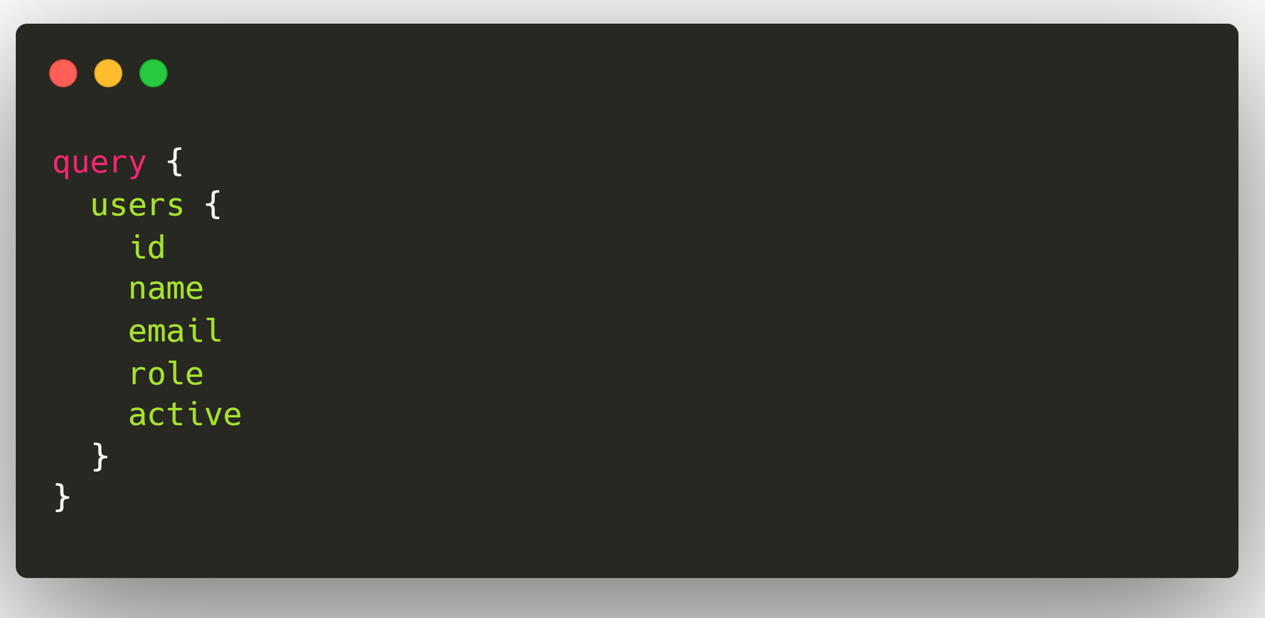
GraphQL
GraphQL is an alternative to REST that allows clients to request exactly the data they need, making it more efficient for modern applications. Unlike REST, which requires multiple API calls to fetch related data, GraphQL can fetch all necessary data in a single request.
Instead of predefined endpoints, GraphQL exposes a single API endpoint, and the client sends queries to request specific fields.
Example: Fetching user data in a single request.

Slide 9
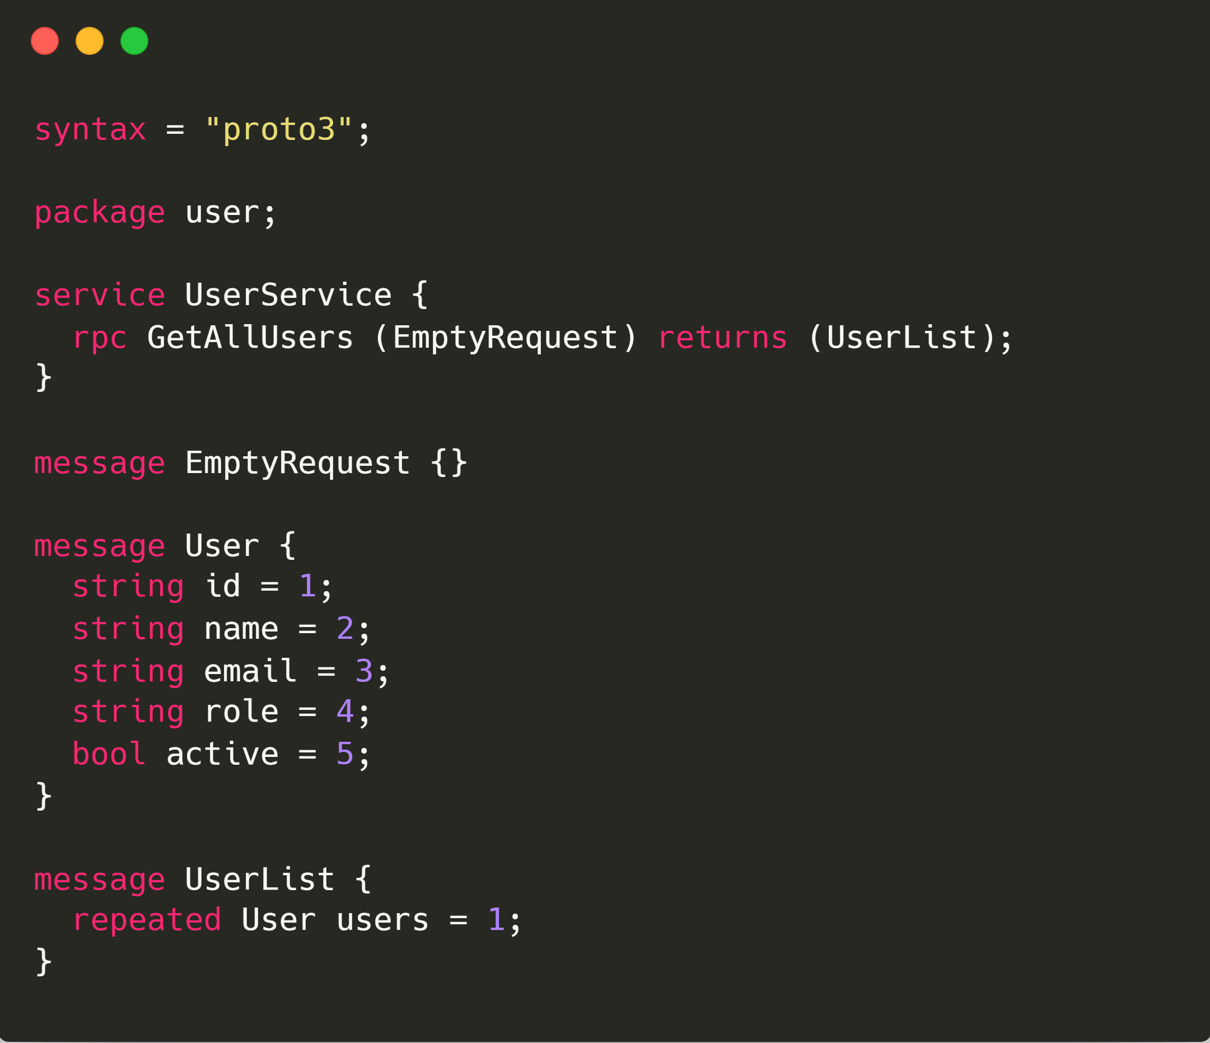
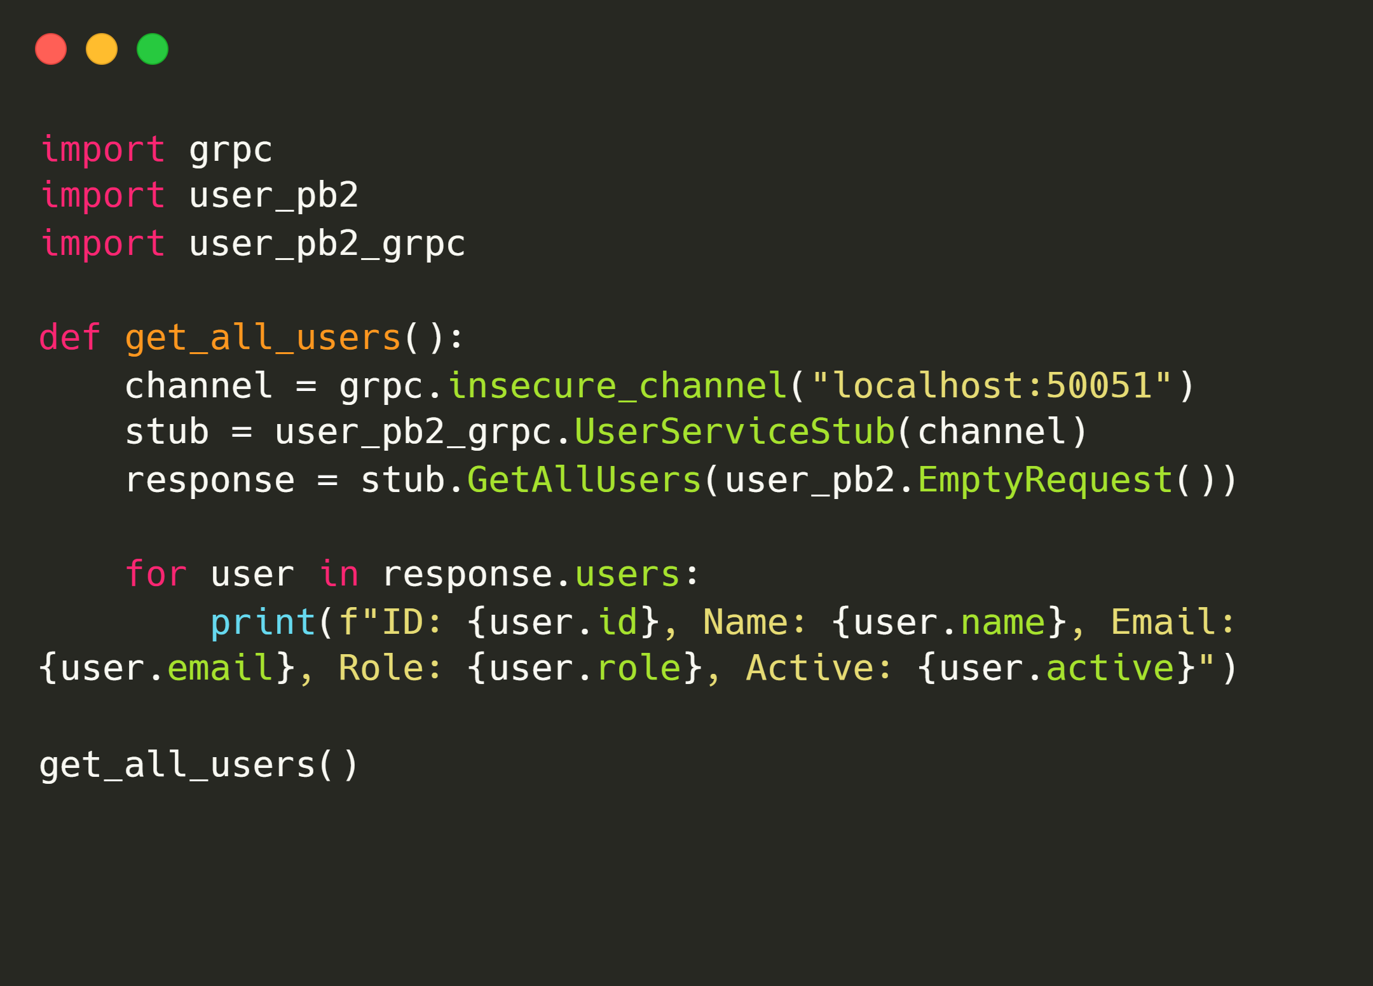
gRPC
gRPC (Google Remote Procedure Call) is a high-performance API communication method that uses Protocol Buffers (Protobuf) instead of JSON or XML, making it faster and more efficient.
gRPC uses binary data format instead of text-based formats, reducing payload size and it supports bidirectional streaming, meaning the client and server can send data at the same time.
1. Define the gRPC Service (Protocol Buffers) || 2. Sample gRPC Client Call (Python Example)

